Slide 1
Y | O | U | R
G | A | M | E

Slide 2
My Family | 100 | 200 | 300 | 400
My Desk Is a Mess | 100 | 200 | 300 | 400
My Dream Town | 100 | 200 | 300 | 400

Slide 3
Find the extra words
Uncle, father, mother, brother, nephew, grandfather
Aunt, cousin, niece, teacher, twins, sister
Узнать ответ

Slide 4
Right answer mother teacher
Вернуться к выбору тем→

Slide 5
Put the letters in the correct order
herfat
etp
incuso
wtnis
Узнать ответ

Slide 6
1. father 2. pet 3. cousin 4. twins
Right answer
Вернуться к выбору тем→

Slide 7
Read the text and fill in the gaps with my/ her/ their
___(1) name is Ted. I’m 11. I have got a sister. ___(2) name is Jessy and there is a mess in ___(3) room. I have got two brothers. They are twins. ___(4) names are Bill and Tony. There are a lot of toys in ___(5) bedroom.
Узнать ответ

Slide 8
1. My 2. Her 3. Her 4. Their 5. Their
Right answer
Вернуться к выбору тем→

Slide 9
Read the text and complete it. You need to count to get the answers
My name is Polly. I am from England. I am eight. I have got a mother, a father and a (six + three) brother. My brother is (four - one) …………… He has got many (five + three) ……………….: cars, robots and (eight + two) ……………….. My brother and I like to run, to jump and to (five-one) ……………
1 – sister | 6 – red
2 – white | 7 – big
3 – ten 4 – draw 5 - brown | 8 – toys 9 – brother 10 - planes
Узнать ответ

Slide 10
Right answer ten toys planes draw
Вернуться к выбору тем→

Slide 11
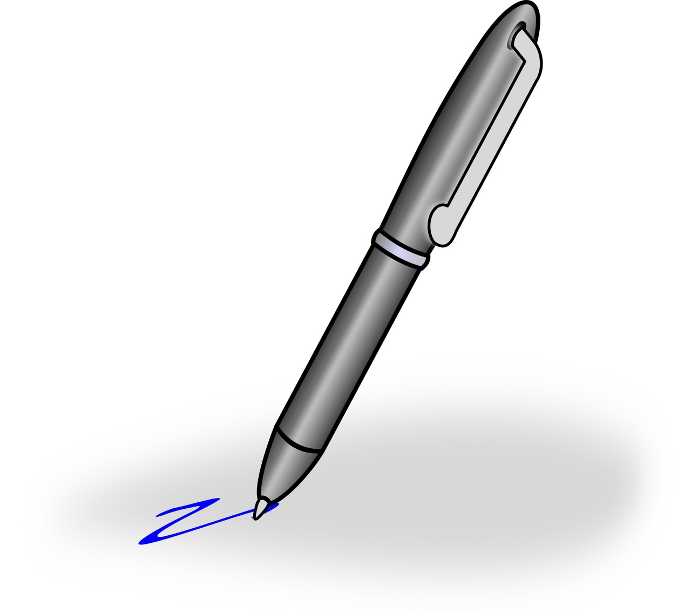
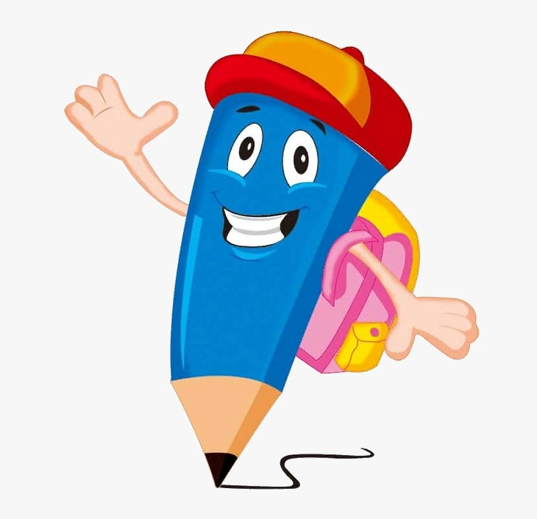
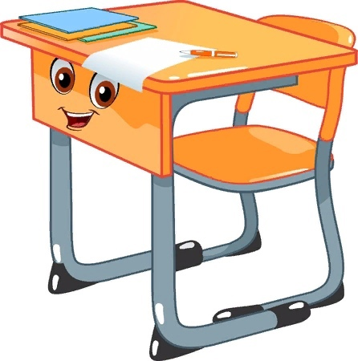
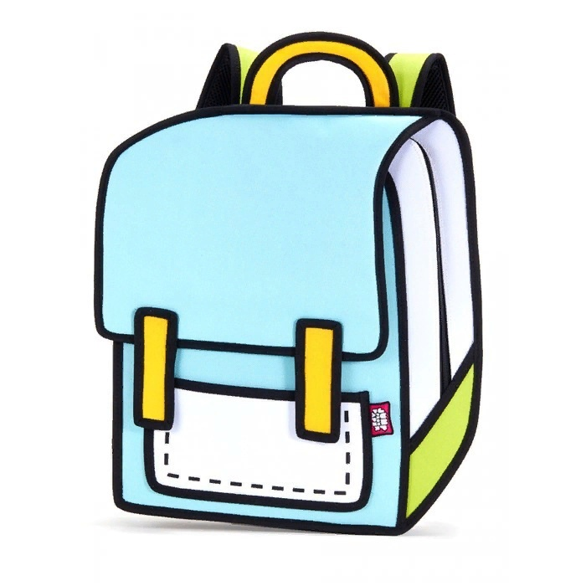
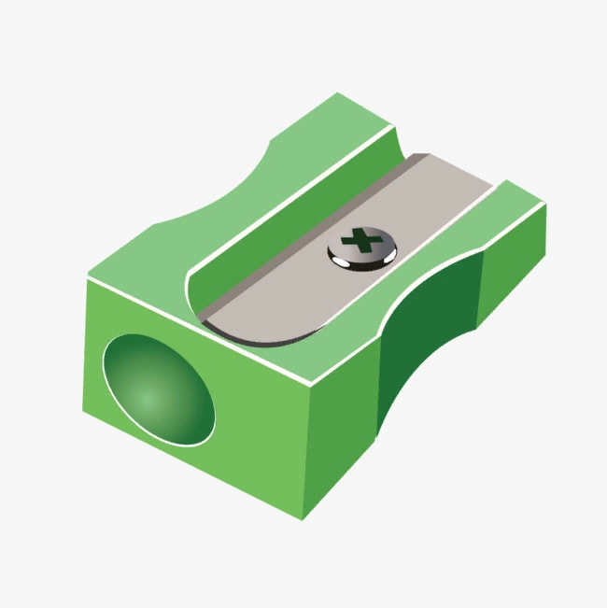
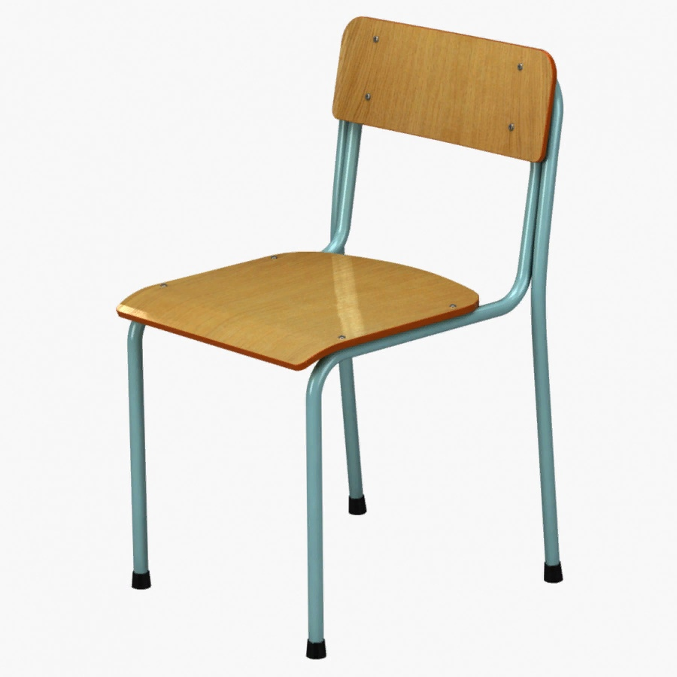
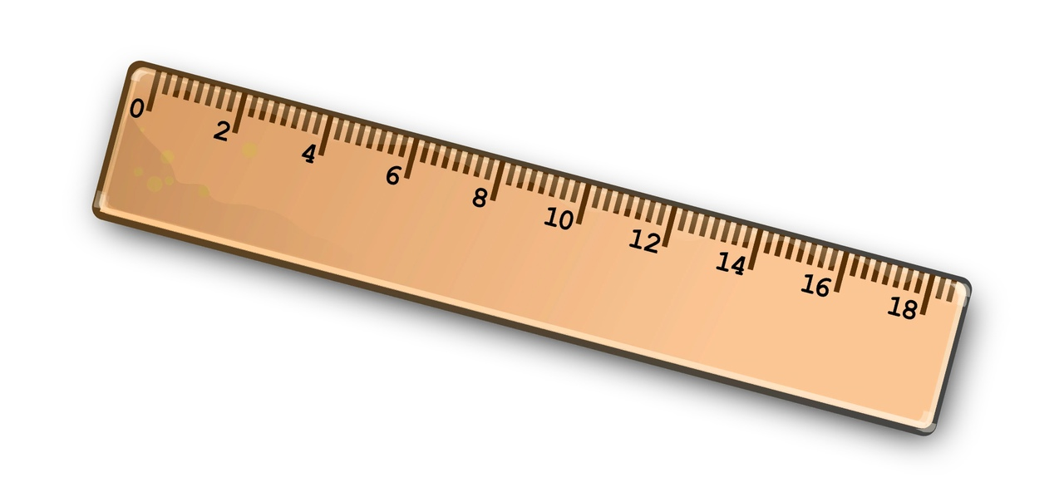
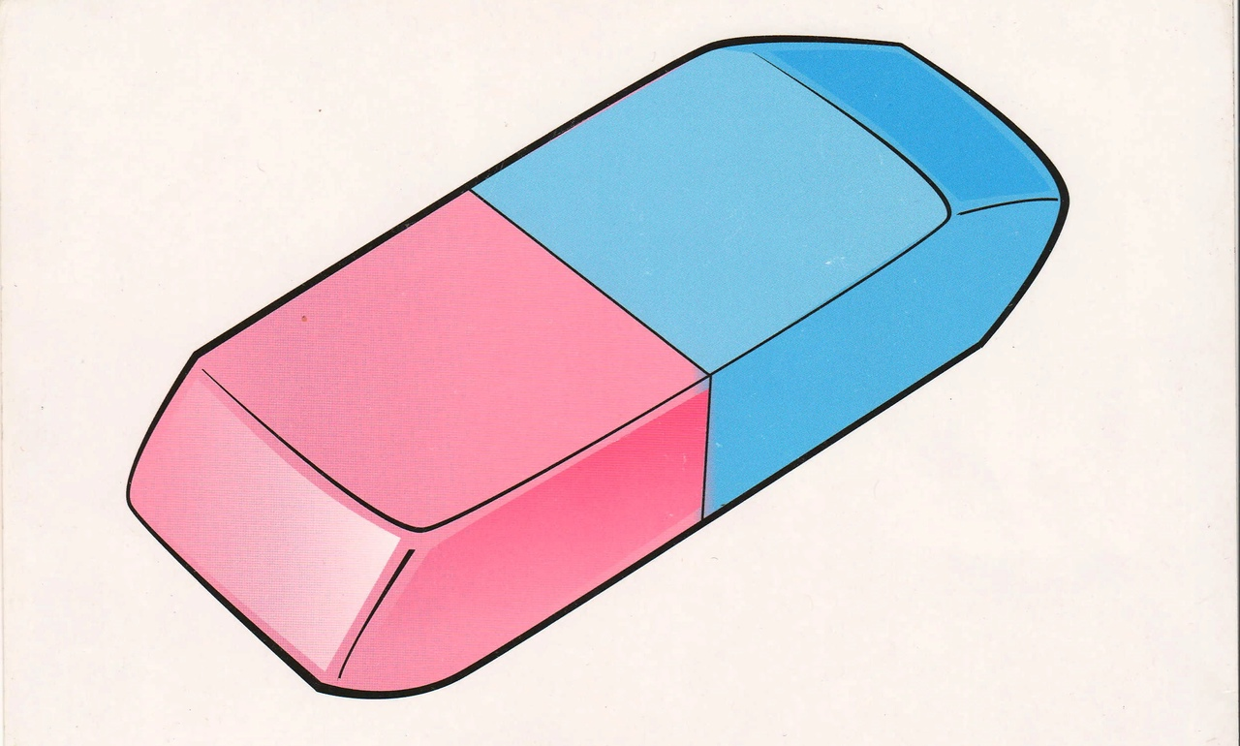
Name the pictures
Узнать ответ

Slide 12
Right answer pen pencil desk bag books pencil case ruler rubber pencil sharpener chair
Вернуться к выбору тем→

Slide 13
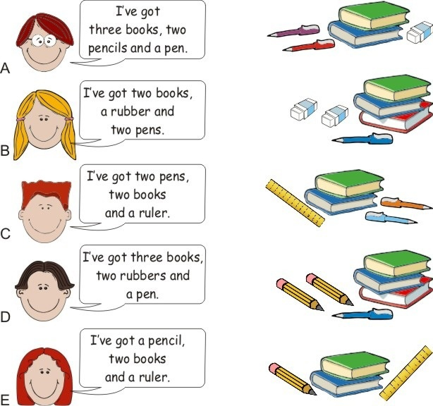
1
2
Match A-D with 1-5
3
4
5
Узнать ответ

Slide 14
Right answer
A – 4
B – 1
C – 3
D – 2
E – 5
Вернуться к выбору тем→

Slide 15
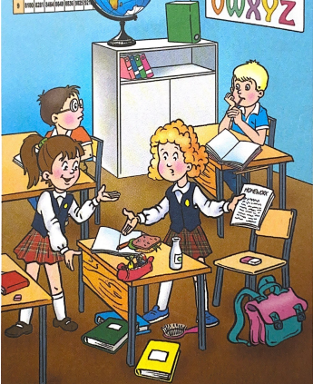
Find and say where the rubber, pen, bag, books, pencil case are.
Use the prepositions and there is/are
“There is a rubber on the chair”
Узнать ответ

Slide 16
Right answer
There is a rubber on the chair
There is a pen on the textbook
There is a bag near/next to the chair
There are books on the floor/ under the desk
There is a pencil case on the desk
Вернуться к выбору тем→

Slide 17
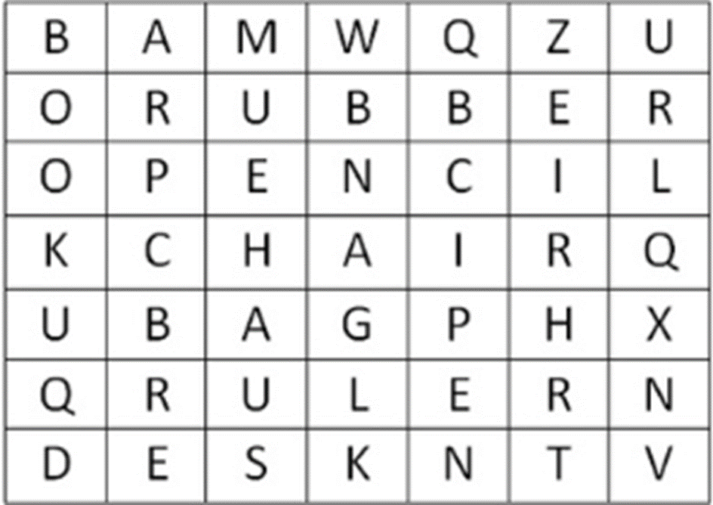
Find the words
Узнать ответ

Slide 18
Right answer
Вернуться к выбору тем→

Slide 19
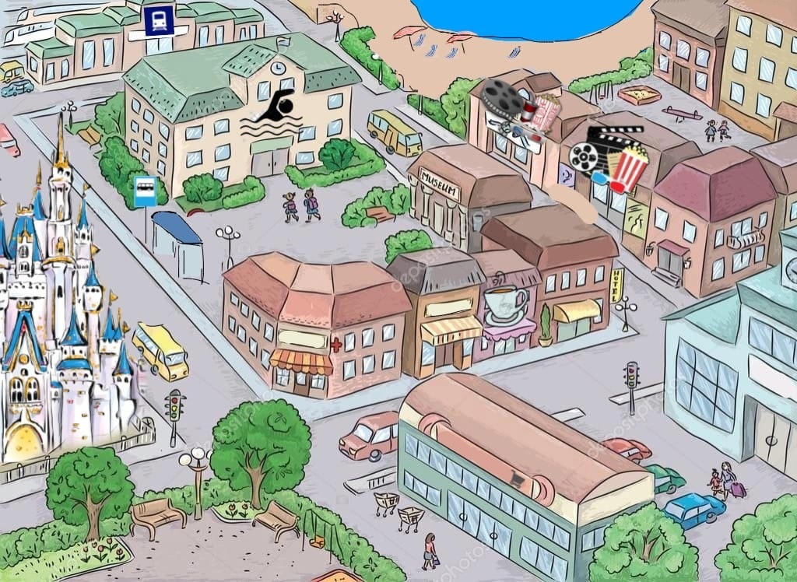
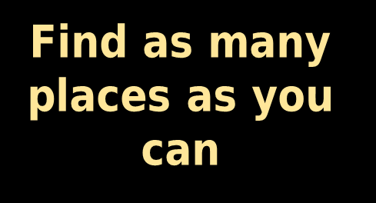
Узнать ответ

Slide 20
Right answer swimming pool beach two cinemas restaurant/café castle bus station railway station supermarket park
Вернуться к выбору тем→

Slide 21
Solve the puzzle
Узнать ответ

Slide 22
Right answer castle
Вернуться к выбору тем→

Slide 23
Complete the text with a/an, any
My town is great! There is …(1) big river and there is …(2) old bridge over it. There isn’t …(3) railway station, but there is …(4) big bus station. There are a lot of restaurants and there aren’t …(5) big supermarkets. What about your town? Are there …(6) museums?
Узнать ответ

Slide 24
Right answer
a
an
a
a
any
any
Вернуться к выбору тем→

Slide 25
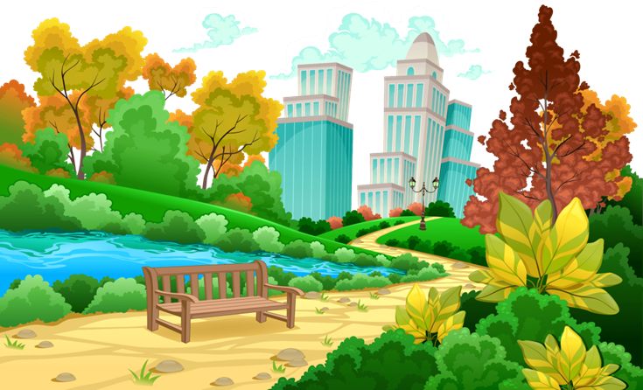
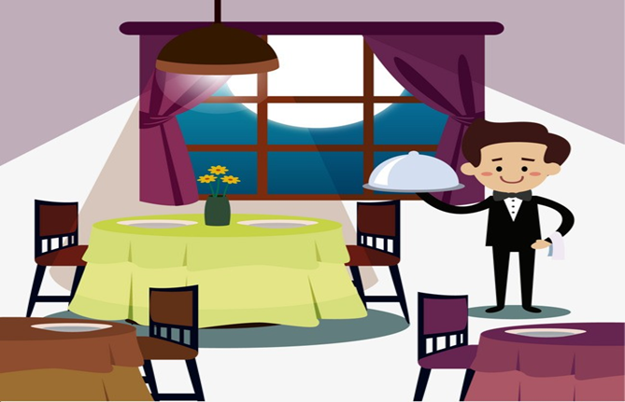
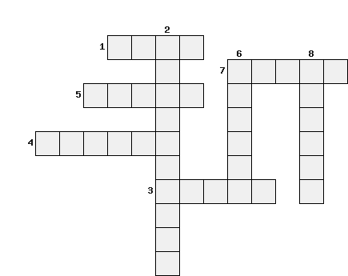
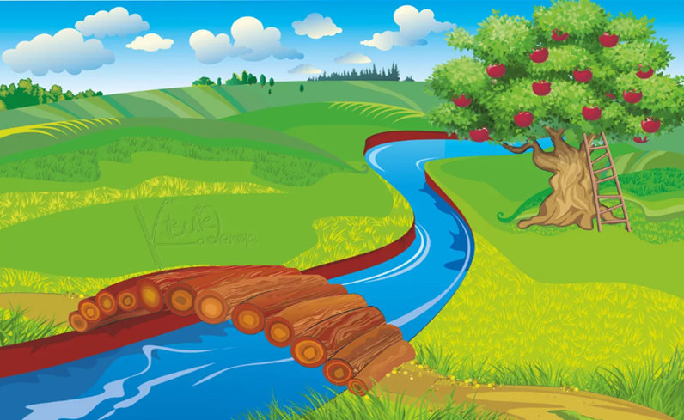
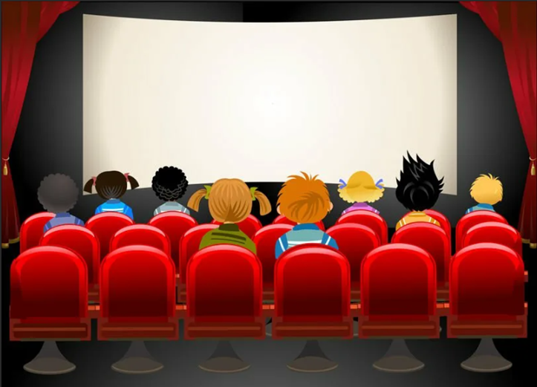
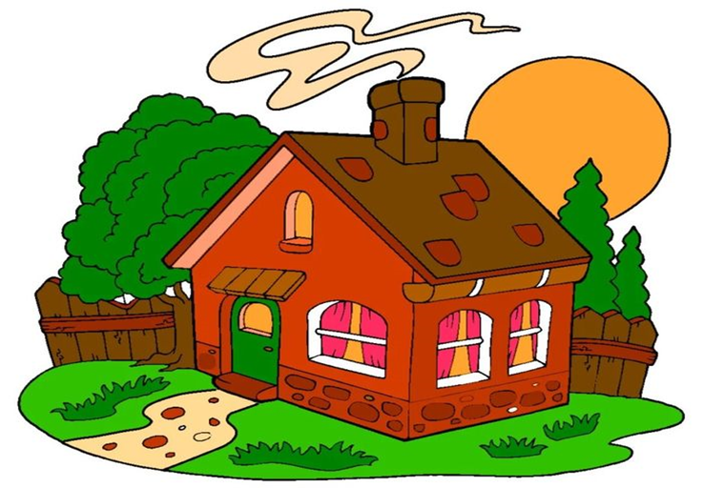
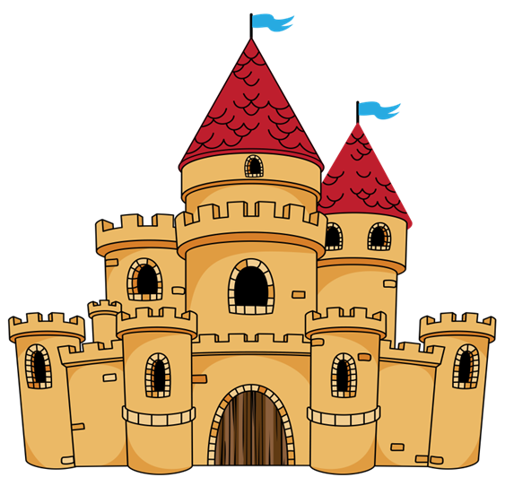
Solve the puzzle
1
2
3
4
5
6
Узнать ответ
7
8

Slide 26
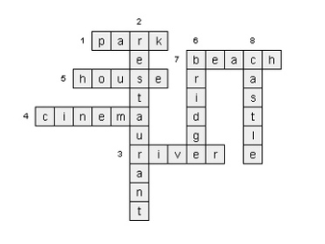
Right answer
Вернуться к выбору тем→

Slide 27
Вернуться к выбору тем→

